Slide 1
16 bit RISC V Processor
ILLURU SAHITYA (2020H1400247H,ME Embedded)
CHIDARA SINDHUJA(2020H1400251H,ME Embedded)
SUKRUTH S(2020H1400236H,ME Embedded)
Supervisor : Prof. M.B.Srinivas

Slide 2
Contents
Objective And Approach
Introduction
Working Model
Instruction Set
RTL Schematics
Simulations Results
Conclusion

Slide 3
Objectives & Approach
To design a 16 bit RISC Processor with RISC V ISA and simulate the same
Approach-Design a ALU,PC,IM,DM and REG modules for the over all processor

Slide 4
Introduction / Background
The reduced instruction set computer, or RISC, is a microprocessor CPU design philosophy that favors a smaller and simpler set of instructions that all take about the same amount of time to execute.
How is RISC different from CISC?
RISC-V (pronounced “risk-five”) is an open, free ISA enabling a new era of processor innovation through open standard collaboration.
Born in academia and research, RISC-V ISA delivers a new level of free, extensible software and hardware freedom on architecture, paving the way for the next 50 years of computing design and innovation.

Slide 5
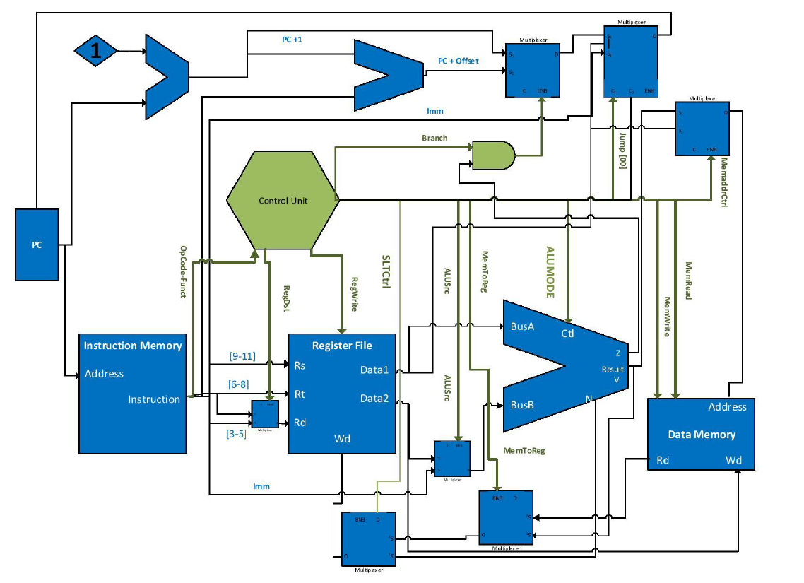
Working Model

Slide 6
Instruction Set
Op Code Value | Function
0001 | Addition of operand 1 and 2
0010 | Subtraction of operand 1 and 2
1100 | AND op1 and op2
1101 | OR op1 and op2
0011 | Branch if less than or equal to
0100 | Branch if equal
0101 | Branch if not equal
0110 | Branch if less than
0111 | LDR immediate
1110 | Jump and link
1000 | LDM immediate
1001 | STM immediate
1010 | Shift left Logical
1011 | Shift right logical
1111 | Jump and link register

Slide 7
RTL Schematics

Slide 8
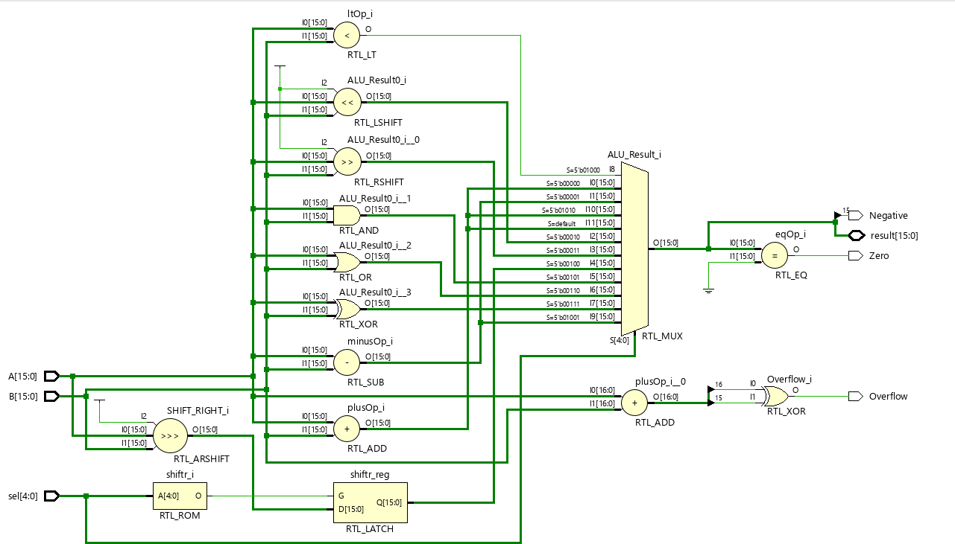
ALU RTL Schematic

Slide 9
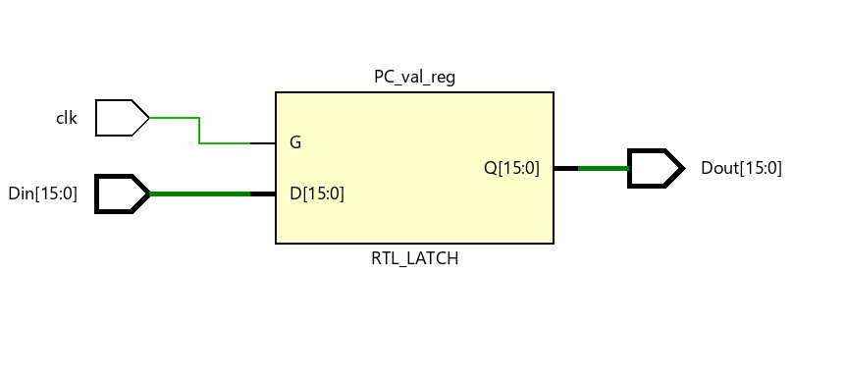
Program counter RTL Schematic

Slide 10
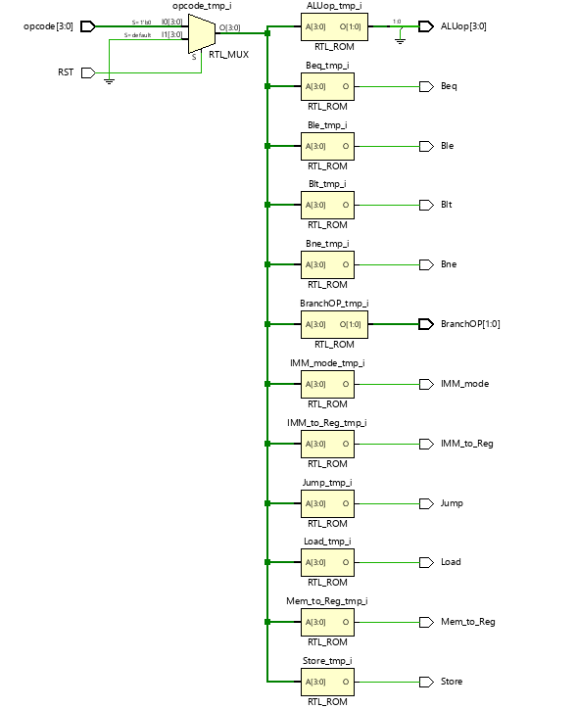
Control Unit RTL Schematic

Slide 11
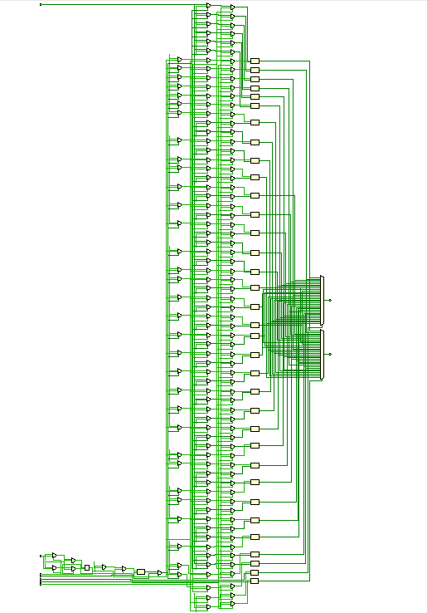
Register RTL Schematic

Slide 12
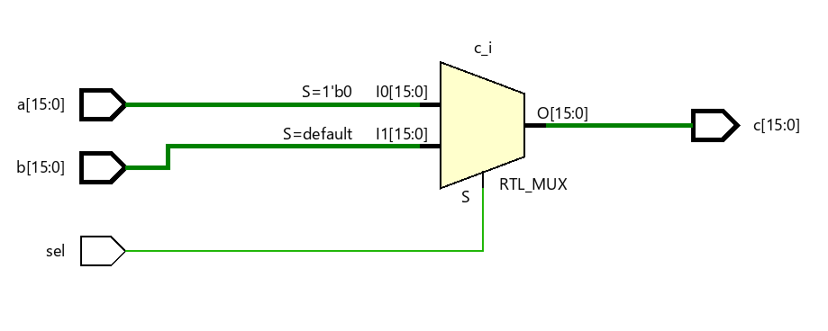
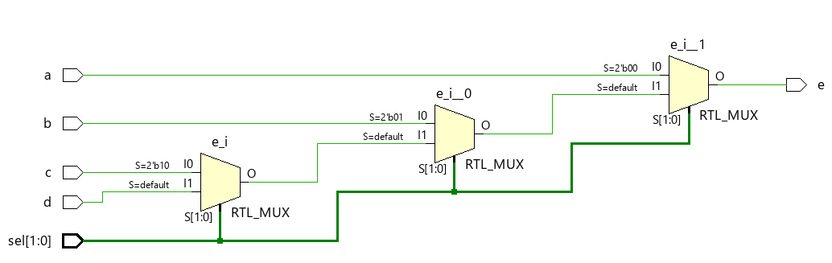
Mux Designs RTL Schematic

Slide 13
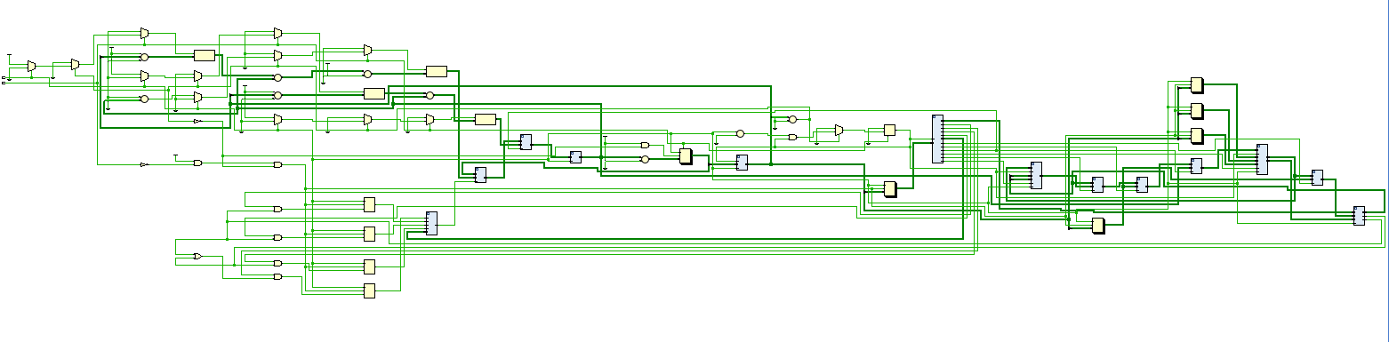
Processor RTL Schematic

Slide 14
Waveforms

Slide 15
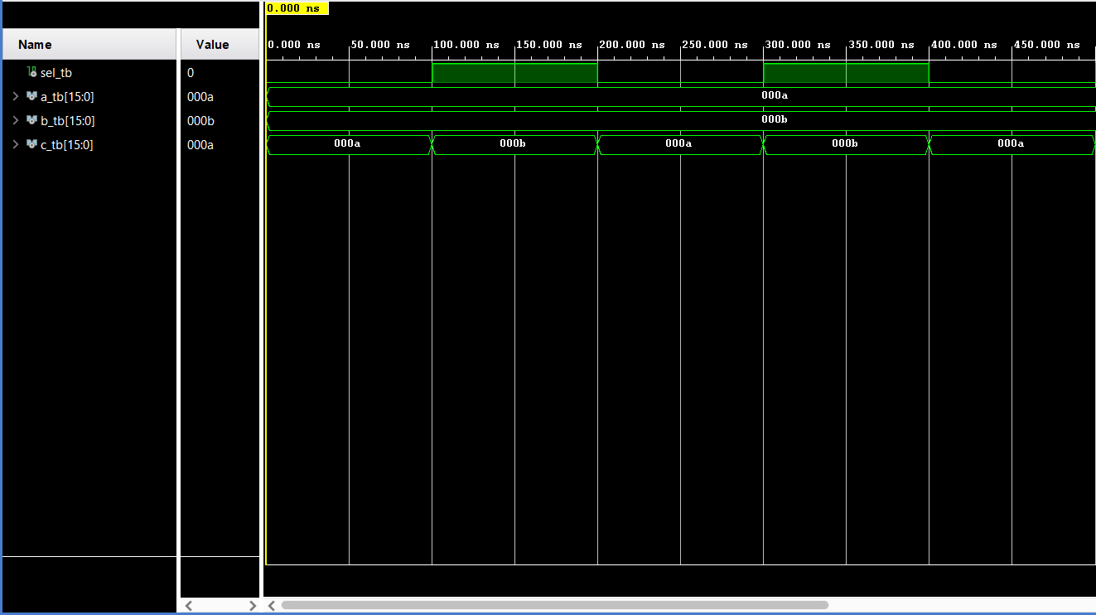
Mux Waveform

Slide 16
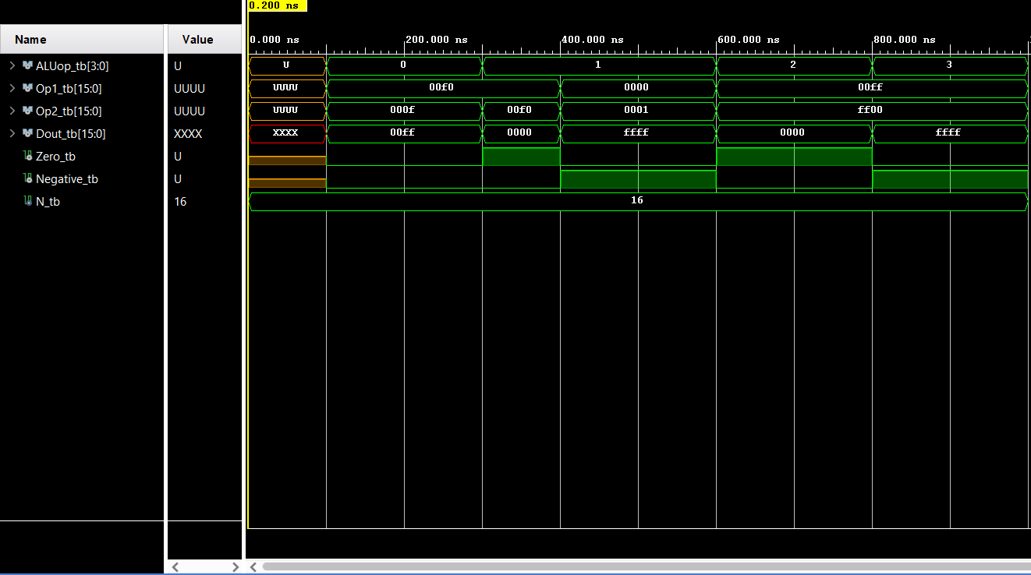
ALU Waveform

Slide 17
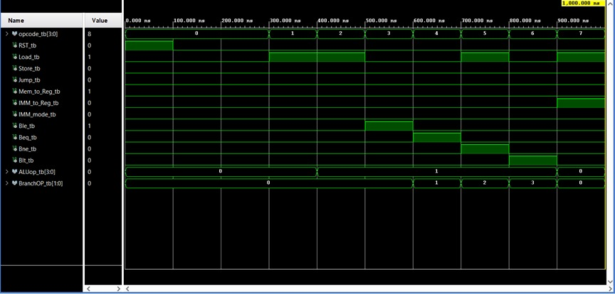
Control unit Waveform

Slide 18
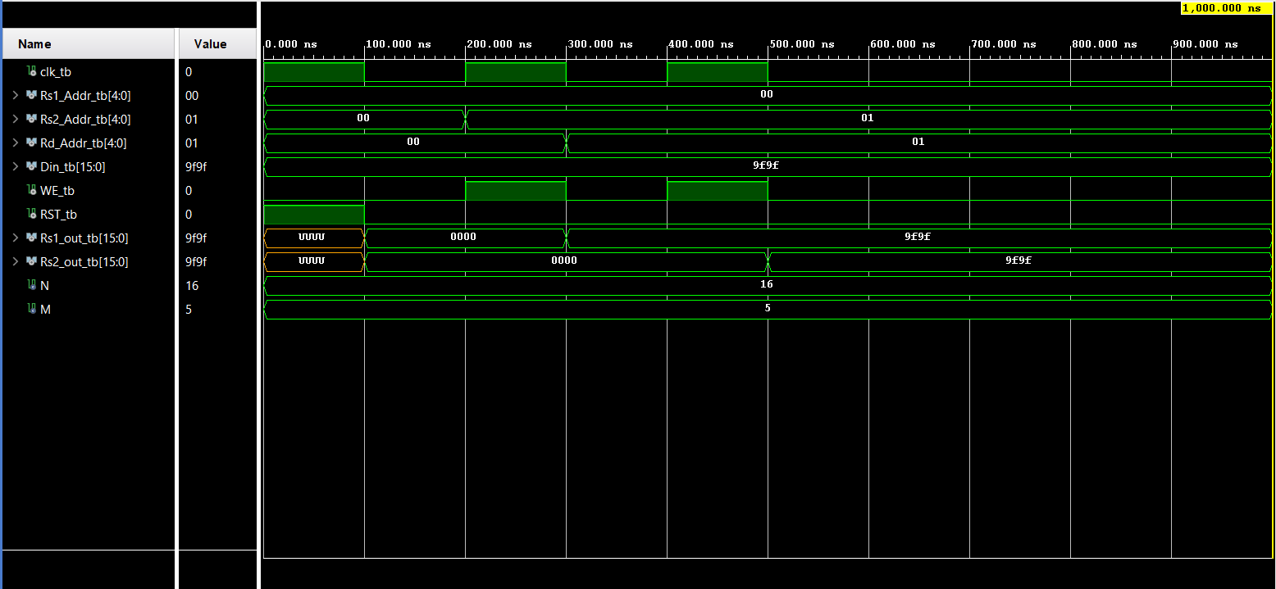
Register Unit Waveform

Slide 19
Conclusion
In this project we were successful in simulating and synthesize the various modules of the 16 bit RISC V ISA project.
Future scope
Pipelining-With Fetch, Decode, Execute and write and read blocks
Expand it to DSP- For convolution
Implement a Wallace tree in Alu for faster calculations

Slide 20
Thank you

